Slide 1
How To Sound Smart ☺
Lightning talk 2017-10-18
By Arnold BARNA

Slide 2

Intelligent wirken ☺
BLITZ Vortrag 2017-10-18
Von Arnold BARNA

Slide 3
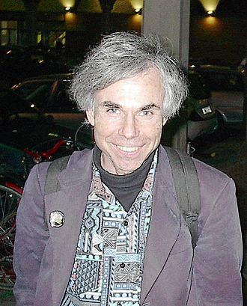
Refer to laws named after personalities
Murphy’s law
Occam's Razor
Hanlon's Razor
Pareto Principle
And many more …

Slide 4
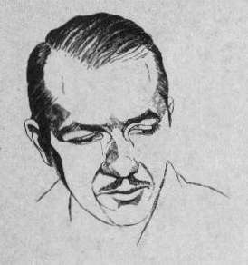
Hanlon's Razor
“Never attribute to malice that which can be adequately explained by stupidity, (but don't rule out malice).”
“Never attribute to malice that which can be adequately explained by stupidity.”
In other words: “Users are not necessarily bad people, maybe only harmless idiots.”

Slide 5
Eagleson's Law
"Any code of your own that you haven't looked at for six or more months might as well have been written by someone else.“
In other words: Clean code helps you as well, not only the others.

Slide 6
Eagleson's Law (cont’d)
“Eagleson is an optimist; the real number is more like 3 weeks.”
In other words: Clean code helps you a lot,
and maybe sometimes the others.

Slide 7
Hofstadter's Law (Professor @Stanford)
"It always takes longer than you expect, even when you take into account Hofstadter's Law."

Slide 8
The 90-90 Rule (Tom Cargill @Bell Labs)
“The first 90 percent of the code accounts for the first 90 percent of the development time.
The remaining 10 percent of the code accounts for the other 90 percent of the development time.”
In other words: If you think you’re almost ready, you’re only halfway done.

Slide 9
Parkinson's Law (British naval historian)
“Work expands so as to fill the time available for its completion.”
If you wait until the last minute, it only takes a minute to do.
Data expands to fill the space available for storage.

Slide 10
Thank you for the attention
Available on GitHub:
Code:
https://github.com/greenfox-academy/bramble100/tree/master/week-07/lightning-talk
Slides:
https://github.com/greenfox-academy/bramble100/tree/master/week-07/lightning-talk

